Slide 1
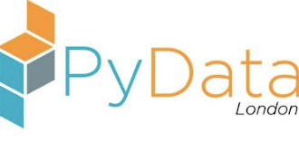
Python in Microcomputers an open-source example
Kevin Machado-Gamboa
London, December 3, 2019

Slide 2
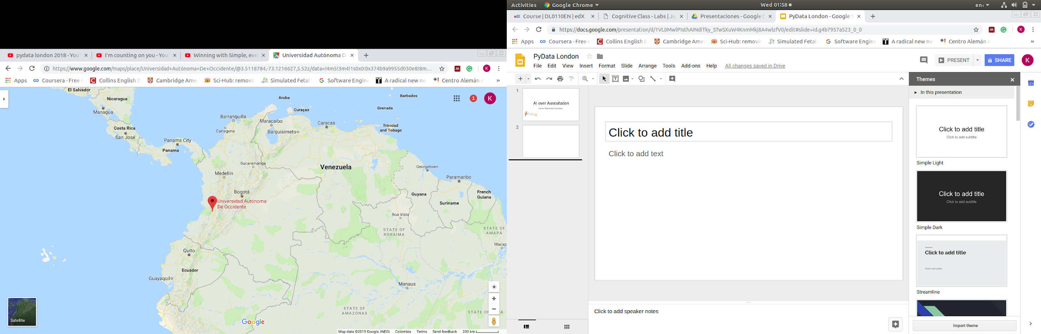
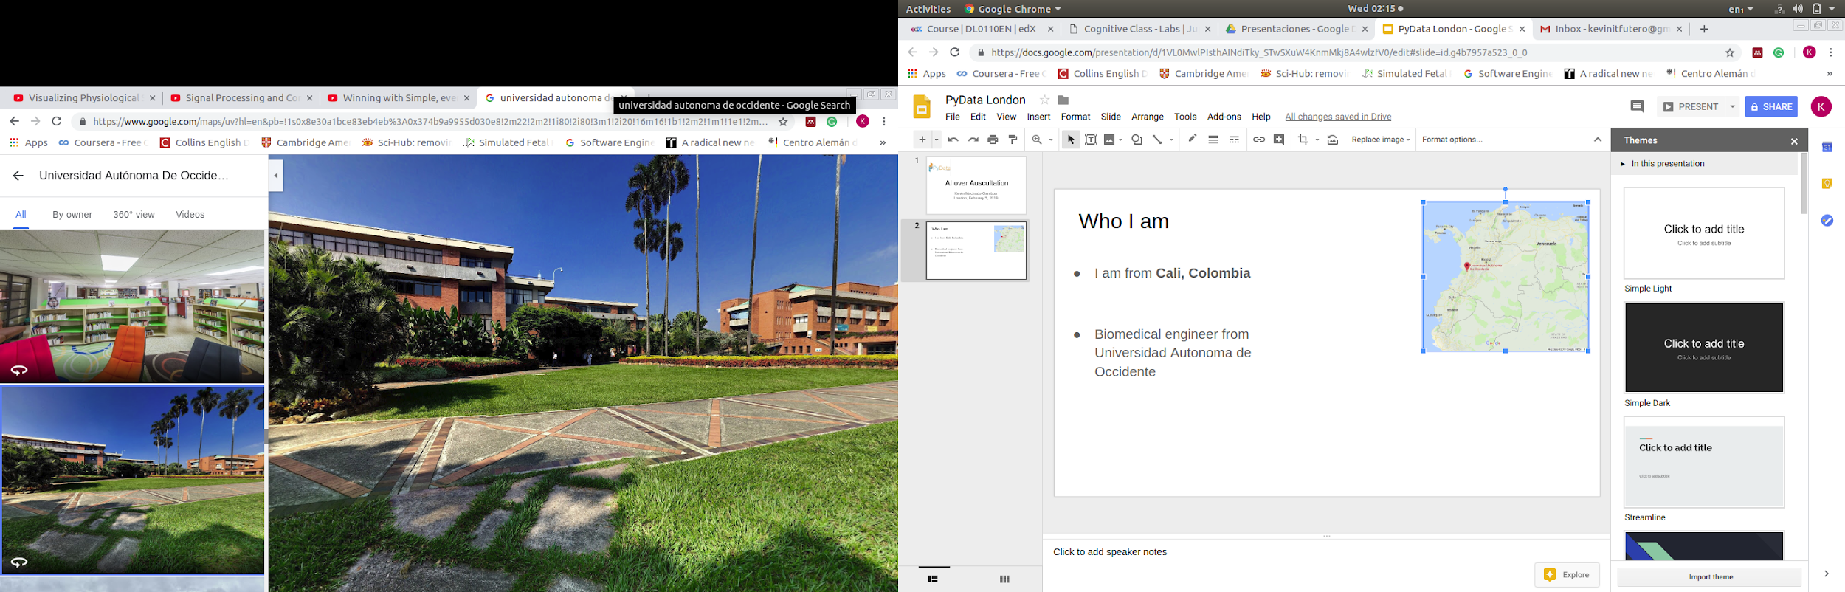
Project Origin
Cali, Colombia
The Biomedical Engineering Research Group, GBIO
Biomedical engineer from Universidad Autonoma de Occidente
Notes:
Sistema fotovoltaico que genera un poco mas del 15% de la energía que consume

Slide 3
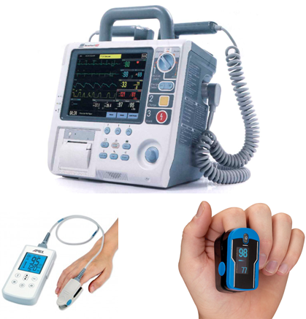
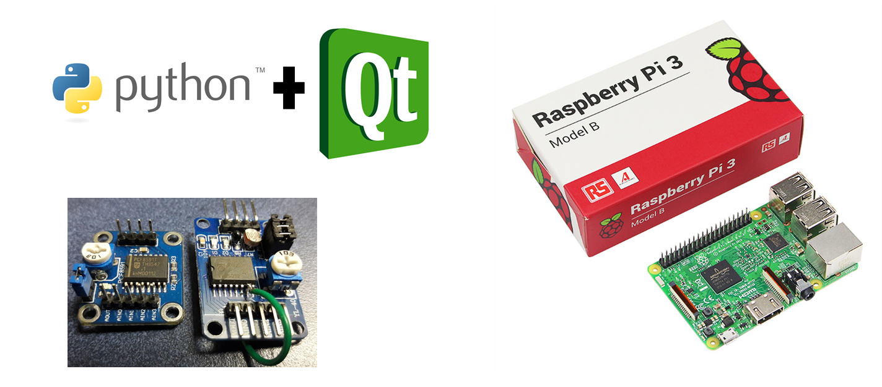
Development of a low-cost pulse oximeter simulator for educational purposes

Slide 4
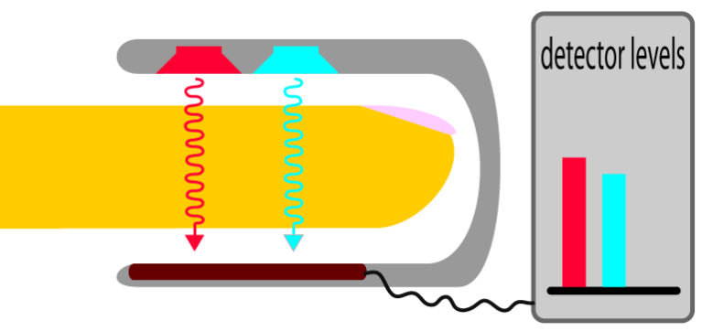


MARCO TEÓRICO
Red light emition diode
Infrared light emition diode
Red-Infrared light detector
Referencia: https://www.howequipmentworks.com/pulse_oximeter/

Slide 5
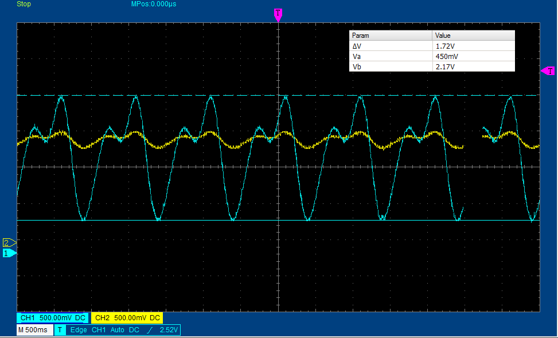
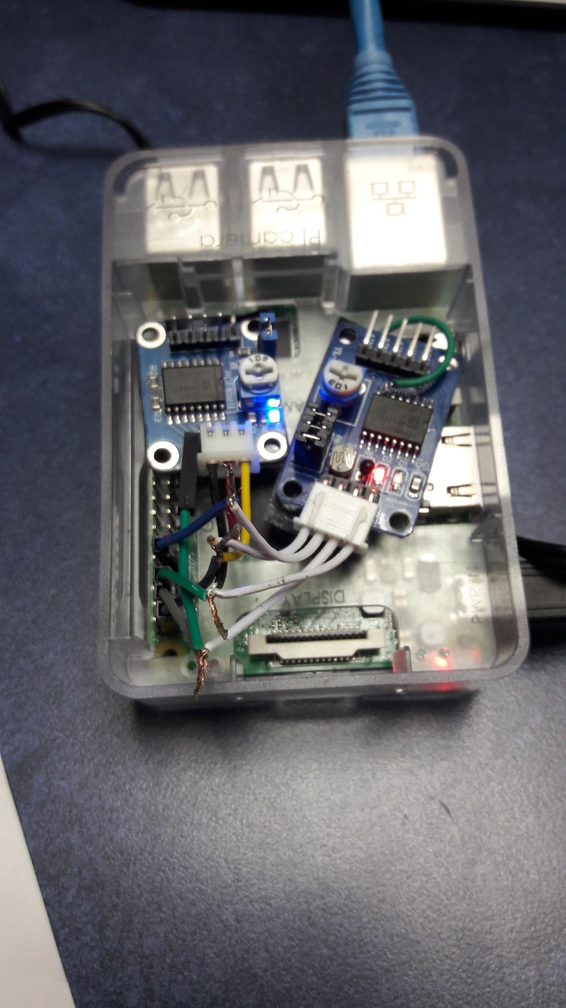
SEÑAL SIMULADA DESDE LA INTERFAZ
Materialización de señales de excitación para los diodos rojo e infrarrojo
Señales de excitación para los diodos rojo e infrarrojo Osciloscopio

Slide 6
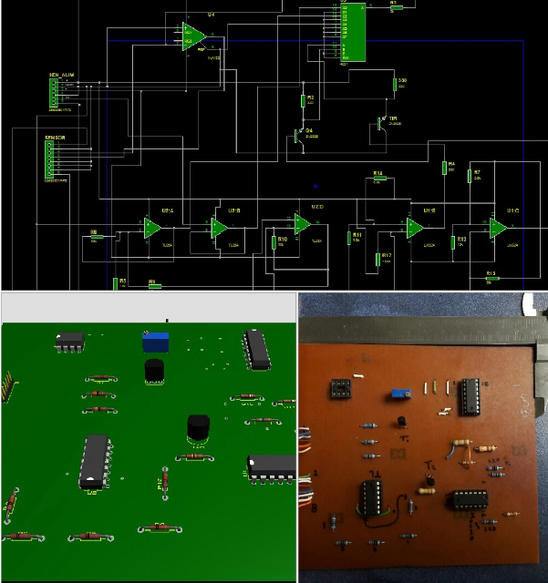
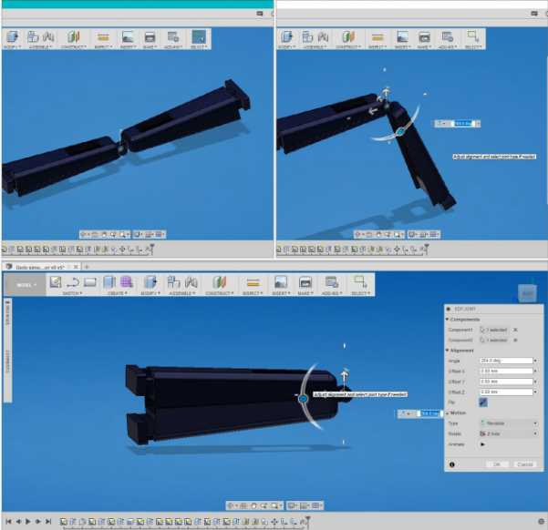
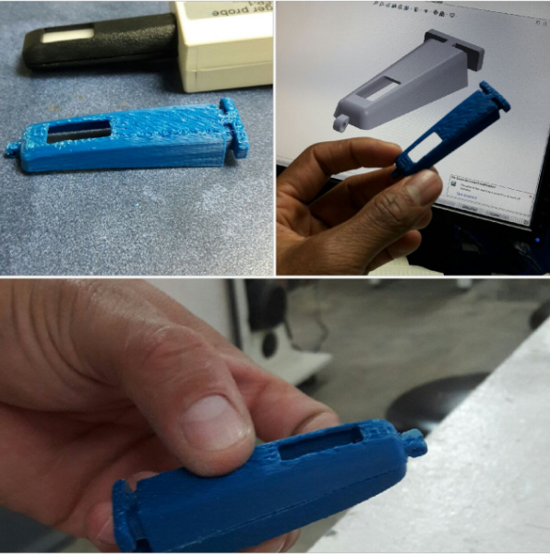
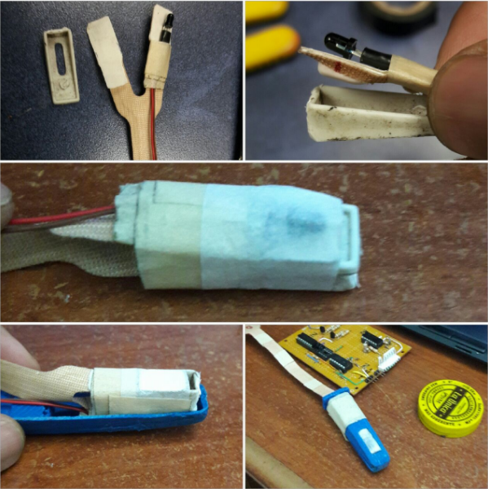
Construcción de tarjeta impresa
Design using free software Fusion 360
Artificial finger printed in PLC

Slide 7

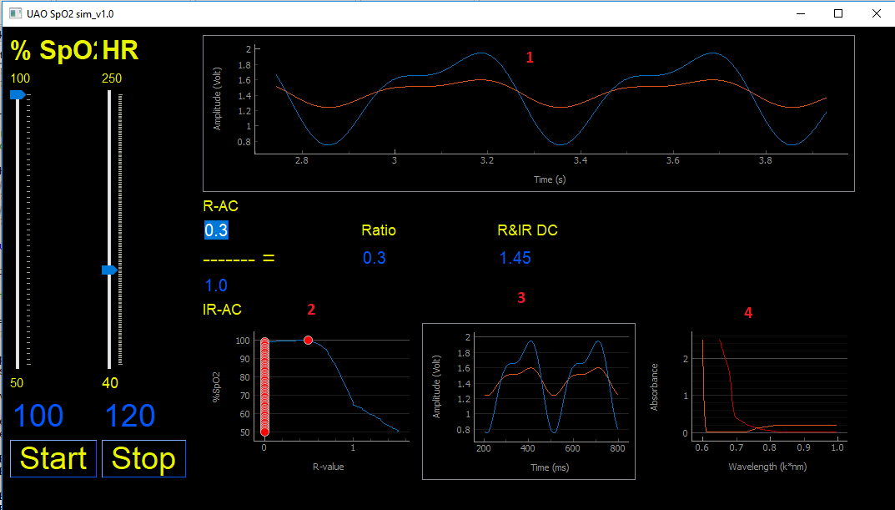
Graphical User Interface
References:
https://ieeexplore.ieee.org/document/8564698
https://github.com/LatinAmericanProgramer/UAO_SpO2_Sim

Slide 8
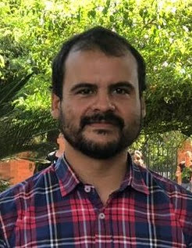
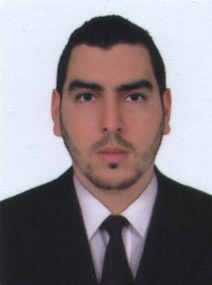
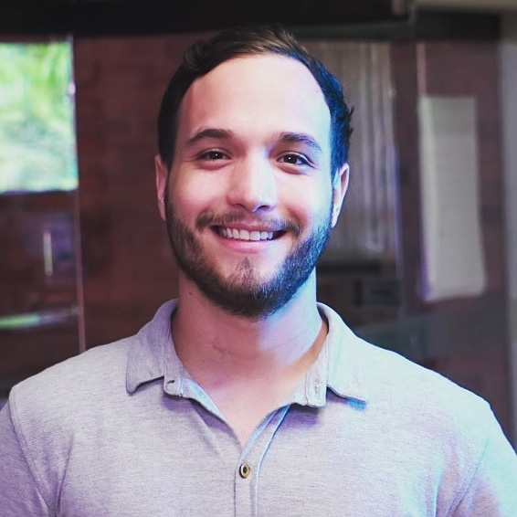
The GBIO Team
Andrés Mauricio González Vargas
Director of the Research Group GBIO
Universidad Autonoma de Occidente
Julián David Loaiza Duque
Research Assistant, Biomedical Engineer
Universidad Autonoma de Occidente
Julian Camilo Varela
Biomedical Engineer
Universidad Autonoma de Occidente

Slide 9
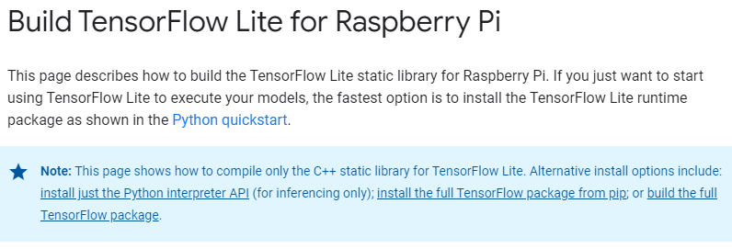
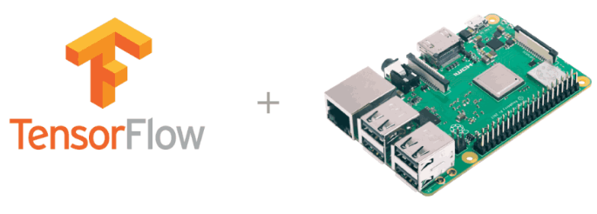
Reference:
https://www.tensorflow.org/lite/guide/build_rpi

Slide 10
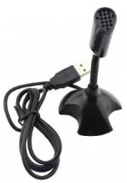
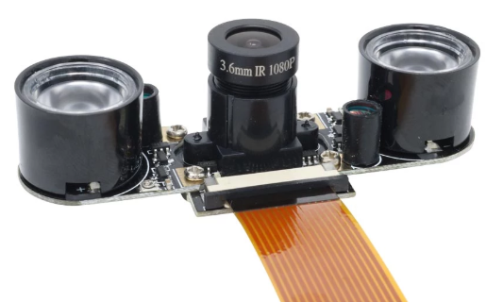
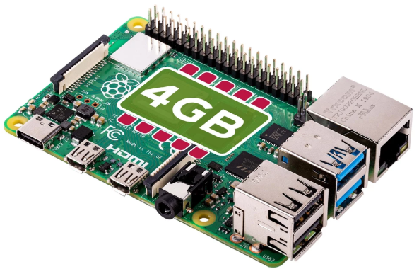
Features
Some Links:
Download TensorFlow 2.0 on RPi https://github.com/lhelontra/tensorflow-on-arm/releases
TensorFlow Examples https://www.tensorflow.org/lite/examples
Object Detection https://github.com/EdjeElectronics/TensorFlow-Lite-Object-Detection-on-Android-and-Raspberry-Pi

Slide 11
Contact details
Linkedin - https://www.linkedin.com/in/kevin-machado-gamboa-b958b6167/
Github - https://github.com/LatinAmericanProgramer
Email: ing.kevin@hotmail.com
Thank you very much

